Slide 1
Database internals - Basics to advanced
- Hrishikesh Kulkarni

Slide 2
Row oriented database
vs
column oriented database
SELECT *
FROM employees
WHERE profile_id=100
SELECT SUM(salary)
FROM employees

Slide 3
Keys in RDBMS
Primary key
Candidate key
Foreign key
We can put constraints on columns (NOT NULL, UNIQUE)

Slide 4
Transaction
Collection of queries
Represents one unit of work
Can have - SELECT, INSERT, UPDATE, DELETE (Data Modificn/Manipuln Lang)
Example
Read lock (Shared lock)
Write lock (Exclusive lock) - Locking at row level, table level or DB level
Commands:
Transaction BEGIN
Transaction COMMIT
Transaction ROLLBACK - Can be user defined or used by system for unexpected ending
Can transaction contain only SELECT (read) statements?

Slide 5
ACID
A: Group of statements in transaction should be treated as single unit. Either success or failed transaction.
C: Database should move from one state to other which is consistent.
I: Result of execution of concurrent transactions == Result of executing transactions serially
D: Once commit is done, data should be persisted
Optimistic lock: No locking. Keep track of value using version/snapshot/last update time (epoch). If change in data - fail transaction. SerializableException
Pessimistic lock: Lock at table/row level - so dirty reads are avoided

Slide 6
Index
Index has pointers to the page (physical location of record's page)
Index can be on single column or multiple columns
B+ tree is used internally
Index improves lookup performance. How?
Index reduces write performance. How?
Types of index:
Clustered index (Physical location storage sorted)
Non-clustered index (Use dense mapping)

Slide 7
How tables and indexes stored on disk?
Logical Table
emp_id | emp_name | emp_dob | emp_salary
1 | Alice | 01.01.1990 | $$$
2 | Bob | 05.04.1992 | $$$
... | ... | ... | ...
1000 | ... | ... | ...
I/O can't read single record, reads page
Page 1 (3 records)
1,Alice,01.01.1990,$|2,Bob,05.04.1992|3,Lorel,01.02.1993
Page 2
(Next 3 records)
…..
Page 334

Slide 8
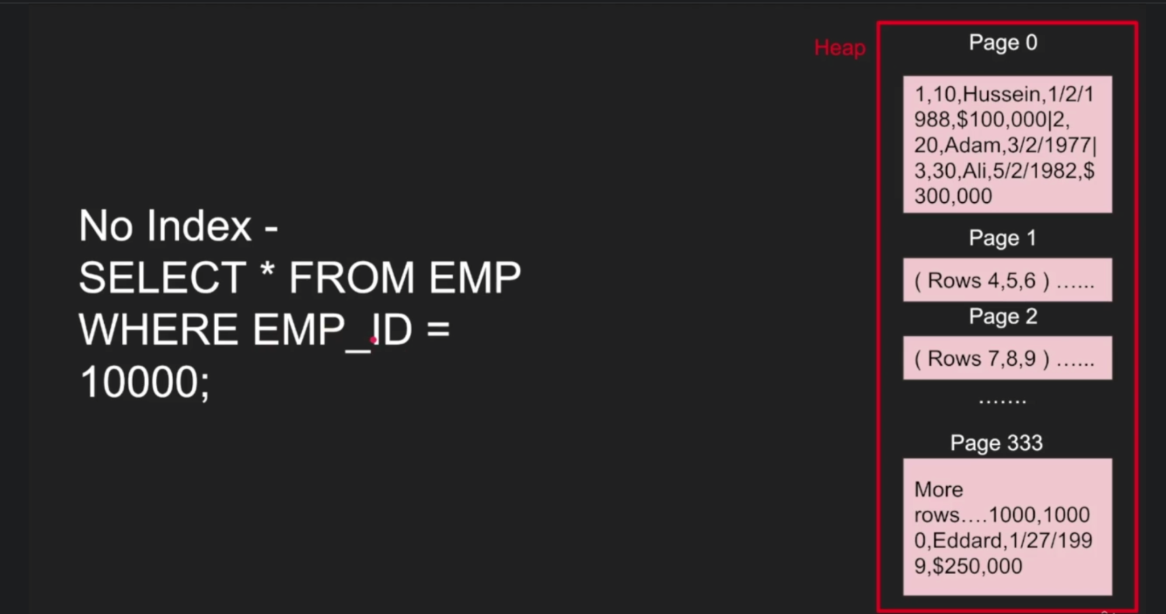
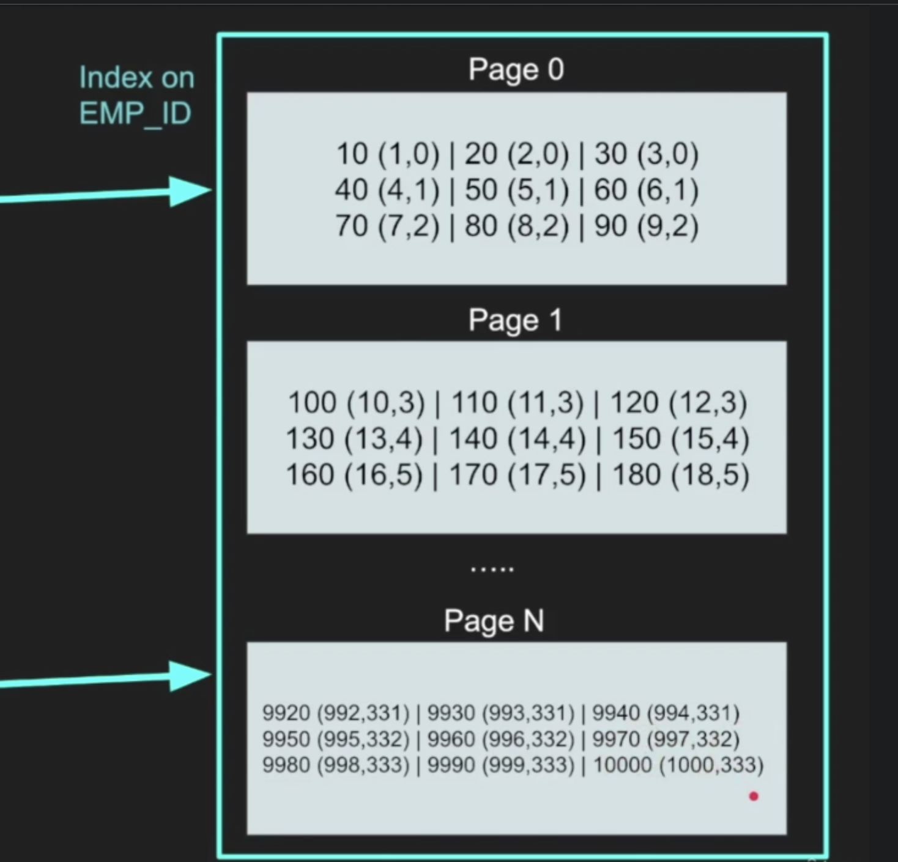

Slide 9
Partition
What is partitioning?
Horizontal partitioning vs Vertical partitioning
Partitioning by
Partition vs shard
Remember:
Quickest way to avoid querying billion rows is avoid querying billion rows

Slide 10
employees
id | name | ...
1 | a1 | ...
2M | ... | ...
id | name | ...
1 | a1 | ...
2 | b1 | ...
3 | c1 | ...
... | ... | ...
... | ... | ...
700001 | za | ...
... | ... | ...
1M | xz | ...
id | name | ...
1 | a1 | ...
200,000 | ... | ...
SELECT *
FROM employees
WHERE id=700,001
id | name | ...
2M1 | abc | ...
4M | ... | ...
id | name | ...
1 | a1 | ...
200,000 | ... | ...
id | name | ...
4M1 | bcd | ...
6M | ... | ...

Slide 11
Partition types
By range (Dates, id range etc)
By unique values (Location name, zip, gender, categorized values)
By hash function

Slide 12
Horizontal Partition vs Sharding
HP splits big table into multiple tables in the same db server (client is agnostic)
Sharding splits big table into multiple table across multiple db servers. Sharding helps to change configuration of diff db servers resulting in scalable solution

Slide 13
Pros and cons
Pros:
Improves query performance due to lesser data in each table
Archive older data by storing partition into cheap storage
Scalability
Cons:
Slow write when updated row needs to move from one partition to another
Inefficient queries may end up looking across all partitions
Schema changes can be difficult
Difficult for transaction across multiple shards
Difficult for joins across multiple shards

Slide 14
Let's design BookMyShow!

Slide 15
Requirements (F and NF)

Slide 16
Estimations

Slide 17
Exposed APIs

Slide 18
High Level Design and DB Schema

Slide 19
Detailed Discussion and Data Flow

Slide 20
Identifying and Resolving bottlenecks

